Slide 1
Progress report
Student : Gabiden Zhurunov
Group : SE-2002

Slide 2
Explanation of the project
Project goal: to create a database for an educational center for the study of English for easy access to all characteristics
The main purpose of my project is to create a common database for each course, that is add information such as:
1) Course name;
2) List of teachers;
3) Duration of the course;
4) Maximum number of students;
5) Course cost;

Slide 3
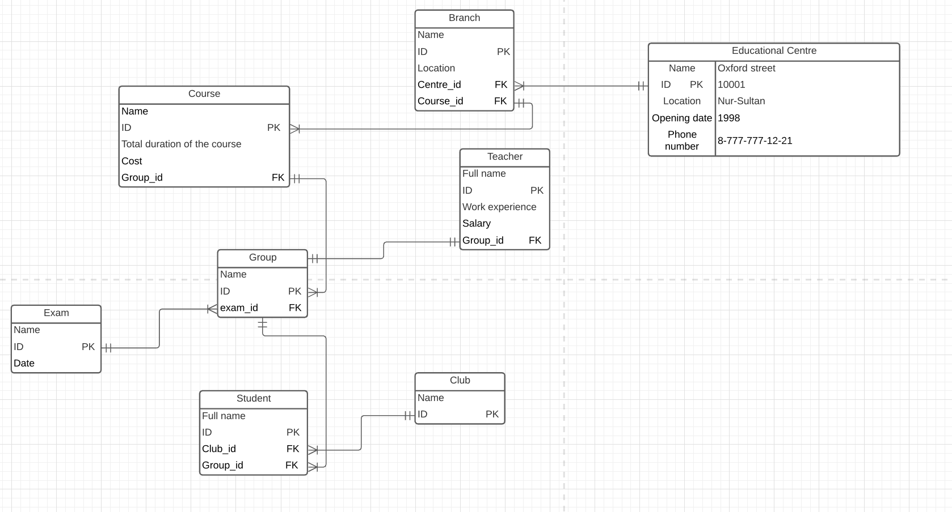

Slide 4
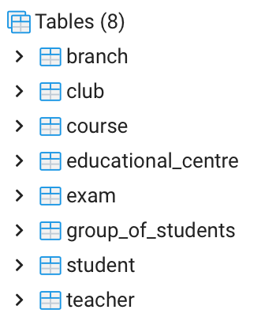

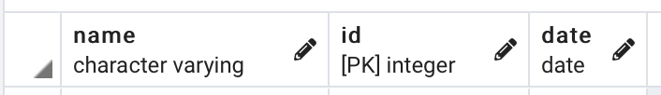

Create table

Slide 5
Code
CREATE TABLE public.educational_centre
(
name character varying COLLATE pg_catalog."default",
id integer NOT NULL,
location character varying COLLATE pg_catalog."default",
opening_date integer,
phone_number bigint,
CONSTRAINT educational_centre_pkey PRIMARY KEY (id)
)

Slide 6
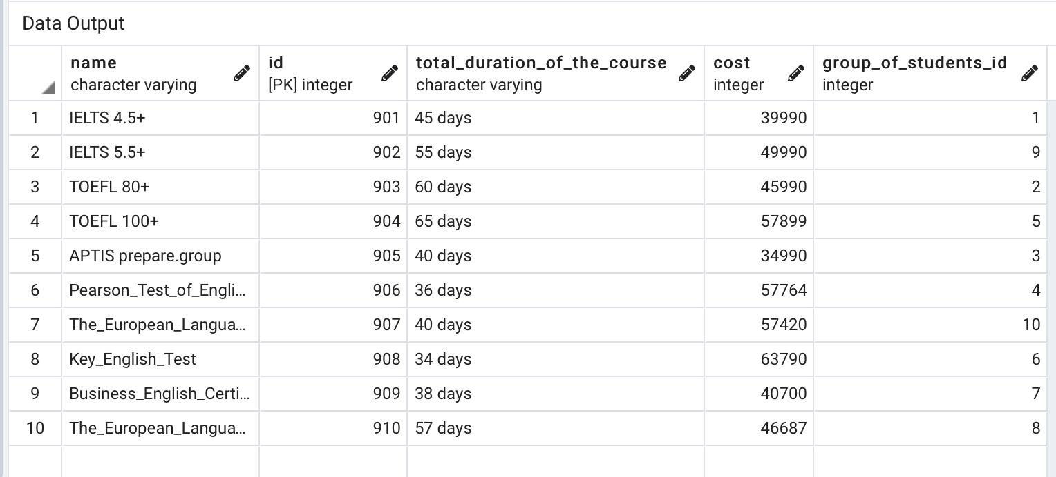
Insert INTO

Slide 7
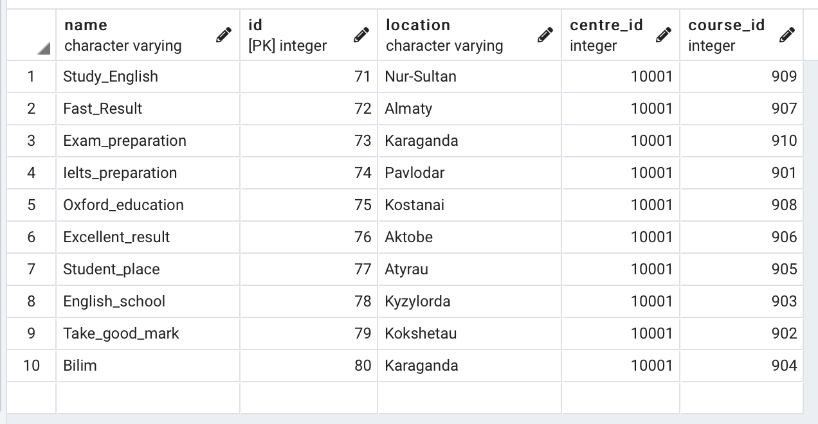
INSERT INTO

Slide 8
Codes
insert into course (name, ID, total_duration_of_the_course, cost, group_of_students_id) values ('IELTS 4.5+', 901, '45 days', '39990', 1);
insert into course (name, ID, total_duration_of_the_course, cost, group_of_students_id) values ('IELTS 5.5+', 902, '55 days', '49990', 9);
insert into course (name, ID, total_duration_of_the_course, cost, group_of_students_id) values ('TOEFL 80+', 903, '60 days', '45990', 2);
insert into course (name, ID, total_duration_of_the_course, cost, group_of_students_id) values ('TOЕFL 100+', 904, '65 days', '57899', 5);
insert into course (name, ID, total_duration_of_the_course, cost, group_of_students_id) values ('APTIS prepare.group', 905, '40 days', '34990', 3);
insert into course (name, ID, total_duration_of_the_course, cost, group_of_students_id) values ('Pearson_Test_of_English', 906, '36 days', '57764', 4);
insert into course (name, ID, total_duration_of_the_course, cost, group_of_students_id) values ('The_European_Language_Certificates', 907, '40 days', '57420', 10);
insert into course (name, ID, total_duration_of_the_course, cost, group_of_students_id) values ('Key_English_Test', 908, '34 days', '63790', 6);
insert into course (name, ID, total_duration_of_the_course, cost, group_of_students_id) values ('Business_English_Certificates', 909, '38 days', '40700', 7);
insert into course (name, ID, total_duration_of_the_course, cost, group_of_students_id) values ('The_European_Language_Certificates', 910, '57 days', '46687', 8);

Slide 9
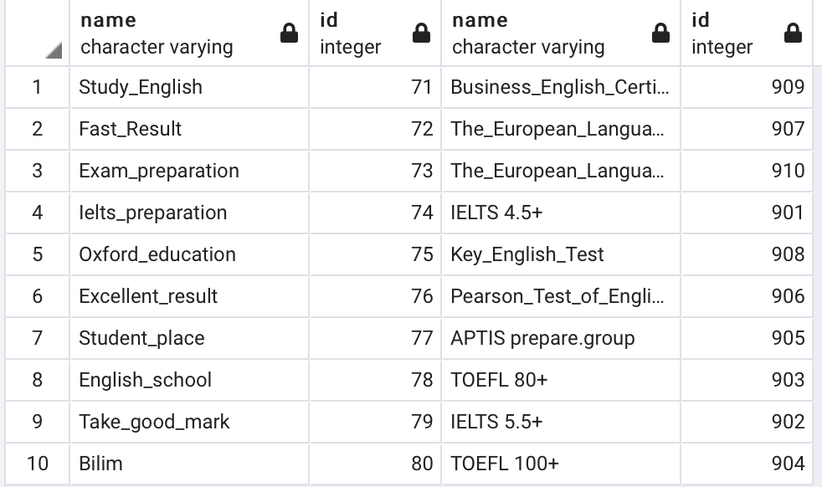
Join
select branch.name,branch.id,course.name,course.id
from branch
inner join course
on branch.course_id=course.id

Slide 10
JOIN
select student.full_name,student.id,group_of_students.name,group_of_students.id,course.name,course.id,club.name,club.id
from student
inner join group_of_students
on student.group_of_students_id = group_of_students.id
inner join course
on course.group_of_students_id = group_of_students.id
inner join club
on student.club_id = club.id

Slide 11
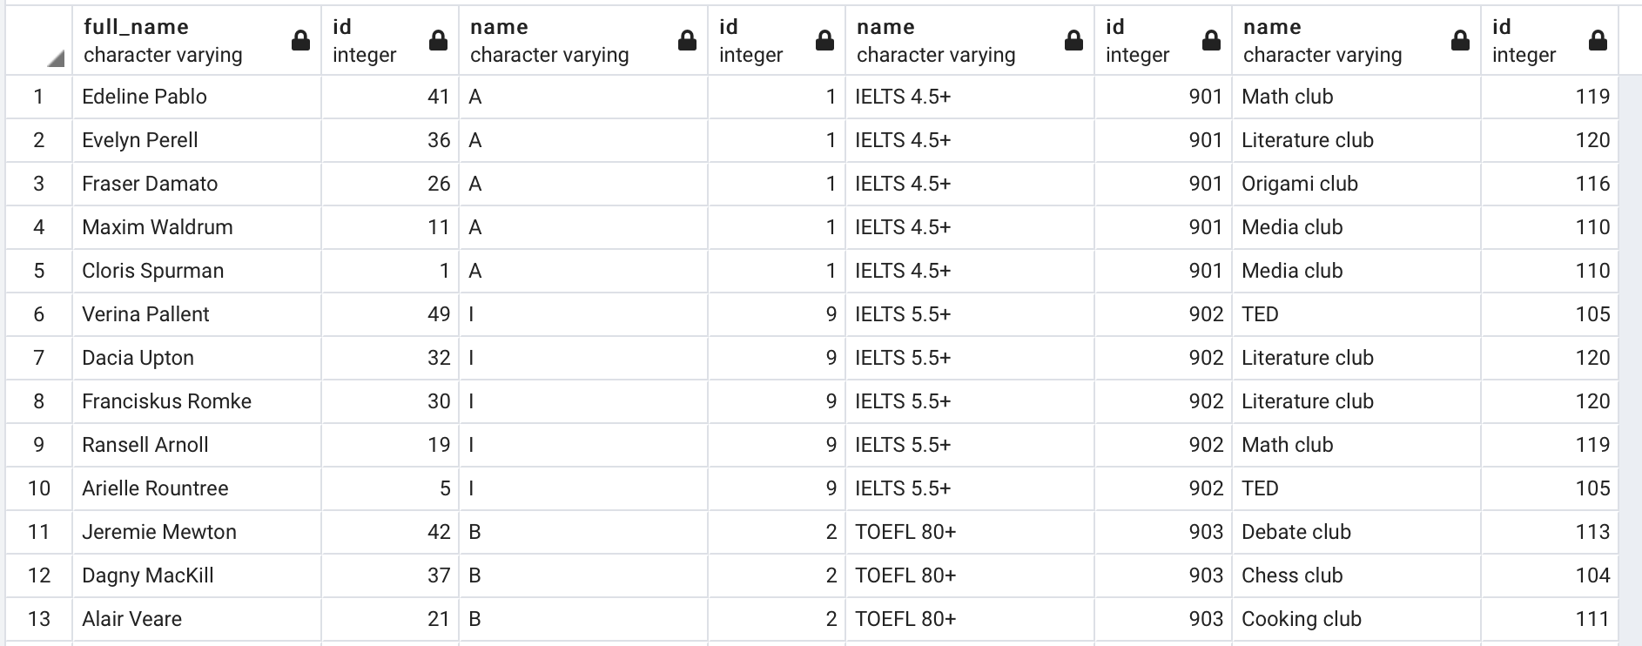
JOIN

Slide 12
Thanks for your attention

